Slide 1
Feature Tracking and Optical Flow
04/07/11
Computer Vision
CS 543 / ECE 549
University of Illinois
Derek Hoiem
Many slides adapted from Lana Lazebnik, Silvio Saverse, who in turn adapted slides from Steve Seitz, Rick Szeliski, Martial Hebert, Mark Pollefeys, and others

Slide 2
Last class
Stitching together a large image by matching points from images from a rotating camera

Slide 3
This class: recovering motion
Feature-tracking
  Extract visual features (corners, textured areas) and “track” them over multiple frames
Optical flow
  Recover image motion at each pixel from spatio-temporal image brightness variations (optical flow)
Two problems, one registration method
B. Lucas and T. Kanade. An iterative image registration technique with an application to
stereo vision. In Proceedings of the International Joint Conference on Artificial Intelligence, pp. 674–679, 1981.

Slide 4
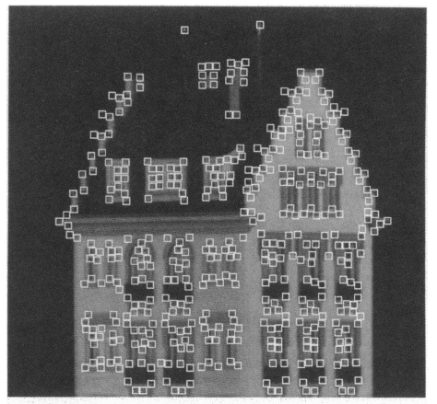
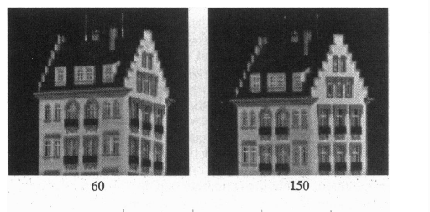
Feature tracking
Many problems, such as structure from motion require matching points
If motion is small, tracking is an easy way to get them

Slide 5
Feature tracking
Challenges
  Figure out which features can be tracked
  Efficiently track across frames
  Some points may change appearance over time (e.g., due to rotation, moving into shadows, etc.)
  Drift: small errors can accumulate as appearance model is updated
  Points may appear or disappear: need to be able to add/delete tracked points

Slide 6
Feature tracking
I(x,y,t)
I(x,y,t+1)
Given two subsequent frames, estimate the point translation
Key assumptions of Lucas-Kanade Tracker
  Brightness constancy: projection of the same point looks the same in every frame
  Small motion: points do not move very far
  Spatial coherence: points move like their neighbors

Slide 7


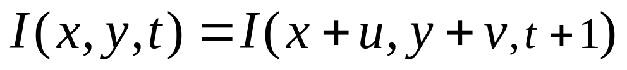
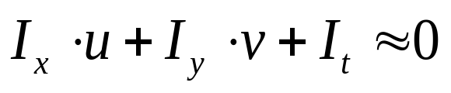
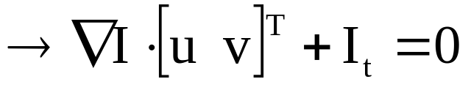
The brightness constancy constraint
I(x,y,t)
I(x,y,t+1)
Brightness Constancy Equation:
Take Taylor expansion of I(x+u, y+v, t+1) at (x,y,t) to linearize the right side:
Image derivative along x
Difference over frames
Hence,
Notes:
Brightness constancy equation is equivalent to minimizing the squared error of I(t) and I(t+1)

Slide 8
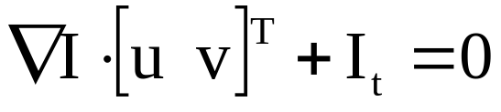
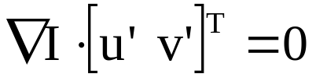
The brightness constancy constraint
Can we use this equation to recover image motion (u,v) at each pixel?
How many equations and unknowns per pixel?
  One equation (this is a scalar equation!), two unknowns (u,v)
The component of the motion perpendicular to the gradient (i.e., parallel to the edge) cannot be measured
  If (u, v) satisfies the equation,
  so does (u+u’, v+v’ ) if
gradient
(u,v)
(u’,v’)
(u+u’,v+v’)
edge
Notes:
A: u and v are unknown, 1 equation

Slide 9
The aperture problem
Actual motion

Slide 10
The aperture problem
Perceived motion

Slide 11

The barber pole illusion
http://en.wikipedia.org/wiki/Barberpole_illusion

Slide 12

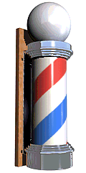
The barber pole illusion
http://en.wikipedia.org/wiki/Barberpole_illusion

Slide 13
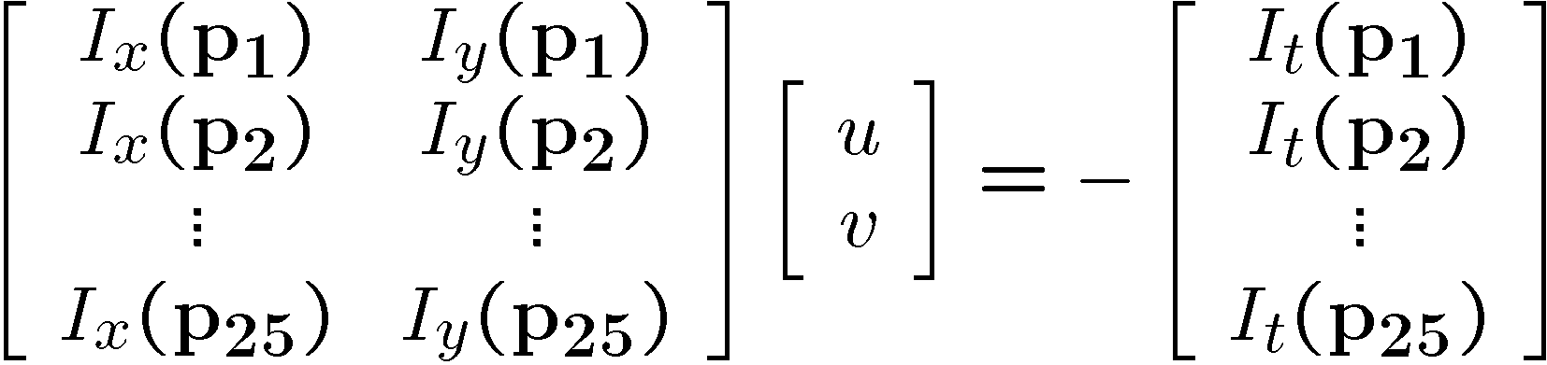
Solving the ambiguity…
B. Lucas and T. Kanade. An iterative image registration technique with an application to stereo vision. In Proceedings of the International Joint Conference on Artificial Intelligence, pp. 674–679, 1981.
How to get more equations for a pixel?
Spatial coherence constraint
Assume the pixel’s neighbors have the same (u,v)
  If we use a 5x5 window, that gives us 25 equations per pixel

Slide 14




Solving the ambiguity…
Least squares problem:

Slide 15

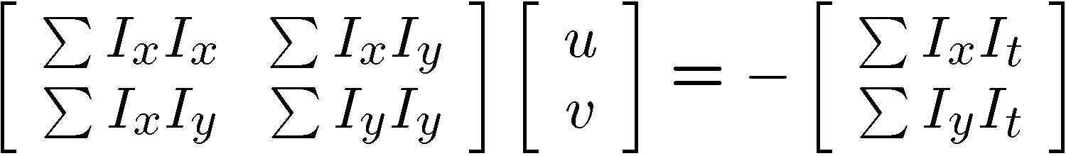


Matching patches across images
Overconstrained linear system
Least squares solution for d given by
  The summations are over all pixels in the K x K window

Slide 16
Conditions for solvability
  Optimal (u, v) satisfies Lucas-Kanade equation
When is this solvable? I.e., what are good points to track?
  A^{T}A should be invertible
  A^{T}A should not be too small due to noise
    eigenvalues λ₁ and λ ₂ of A^{T}A should not be too small
  A^{T}A should be well-conditioned
    λ ₁/ λ ₂ should not be too large (λ ₁ = larger eigenvalue)
Does this remind you of anything?
Criteria for Harris corner detector

Slide 17
M = A^{T}A is the second moment matrix !
(Harris corner detector…)
Eigenvectors and eigenvalues of A^{T}A relate to edge direction and magnitude
  The eigenvector associated with the larger eigenvalue points in the direction of fastest intensity change
  The other eigenvector is orthogonal to it
Notes:
Suppose M = vv^T . What are the eigenvectors and eigenvalues? Start by considering Mv

Slide 18
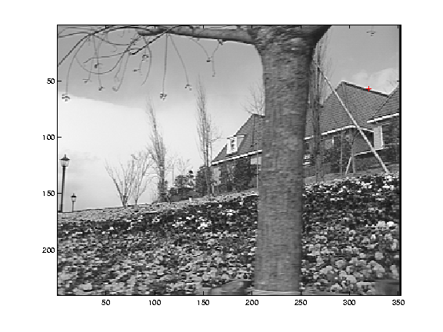
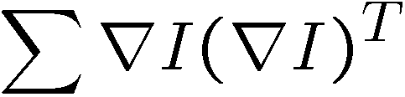
Low-texture region
gradients have small magnitude
small λ₁, small λ₂

Slide 19
Edge
gradients very large or very small
large λ₁, small λ₂

Slide 20
High-texture region
gradients are different, large magnitudes
large λ₁, large λ₂

Slide 21
The aperture problem resolved
Actual motion

Slide 22
The aperture problem resolved
Perceived motion

Slide 23
Dealing with larger movements: Iterative refinement
Original (x,y) position
  Initialize (x’,y’) = (x,y)
  Compute (u,v) by
  Shift window by (u, v): x’=x’+u; y’=y’+v;
  Recalculate I_{t}
  Repeat steps 2-4 until small change
    Use interpolation for subpixel values
I_{t} = I(x’, y’, t+1) - I(x, y, t)
2nd moment matrix for feature patch in first image
displacement

Slide 24
Dealing with larger movements: coarse-to-fine registration
run iterative L-K
upsample
run iterative L-K
.
.
.
image J
image I
image 1
image 2
Gaussian pyramid of image 1 (t)
Gaussian pyramid of image 2 (t+1)

Slide 25
Shi-Tomasi feature tracker
Find good features using eigenvalues of second-moment matrix (e.g., Harris detector or threshold on the smallest eigenvalue)
  Key idea: “good” features to track are the ones whose motion can be estimated reliably
Track from frame to frame with Lucas-Kanade
  This amounts to assuming a translation model for frame-to-frame feature movement
Check consistency of tracks by affine registration to the first observed instance of the feature
  Affine model is more accurate for larger displacements
  Comparing to the first frame helps to minimize drift
J. Shi and C. Tomasi. Good Features to Track. CVPR 1994.

Slide 26
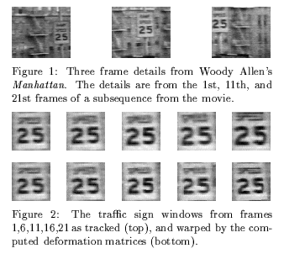
Tracking example
J. Shi and C. Tomasi. Good Features to Track. CVPR 1994.

Slide 27
Summary of KLT tracking
Find a good point to track (harris corner)
Use intensity second moment matrix and difference across frames to find displacement
Iterate and use coarse-to-fine search to deal with larger movements
When creating long tracks, check appearance of registered patch against appearance of initial patch to find points that have drifted

Slide 28
Implementation issues
Window size
  Small window more sensitive to noise and may miss larger motions (without pyramid)
  Large window more likely to cross an occlusion boundary (and it’s slower)
  15x15 to 31x31 seems typical
Weighting the window
  Common to apply weights so that center matters more (e.g., with Gaussian)

Slide 29
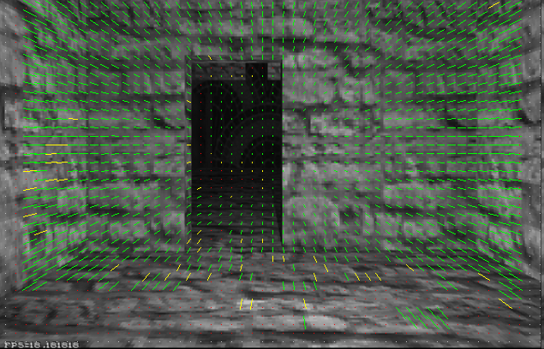
Optical flow
Vector field function of the spatio-temporal image brightness variations
Picture courtesy of Selim Temizer - Learning and Intelligent Systems (LIS) Group, MIT

Slide 30
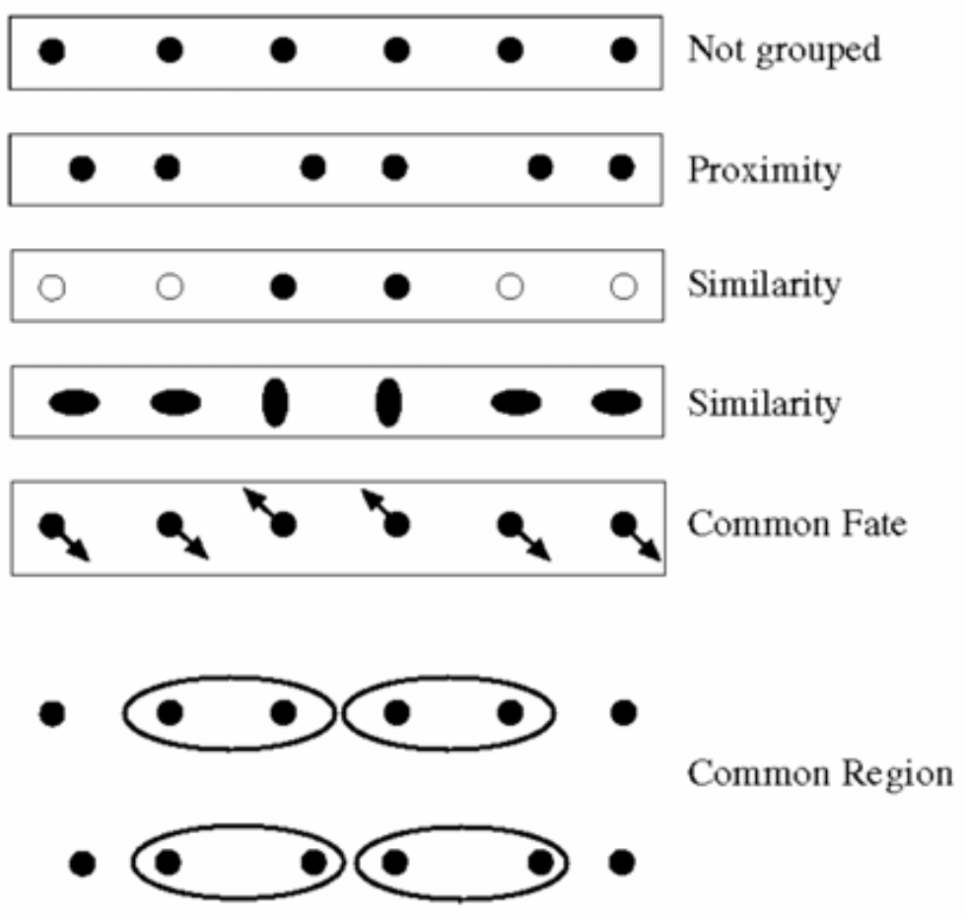
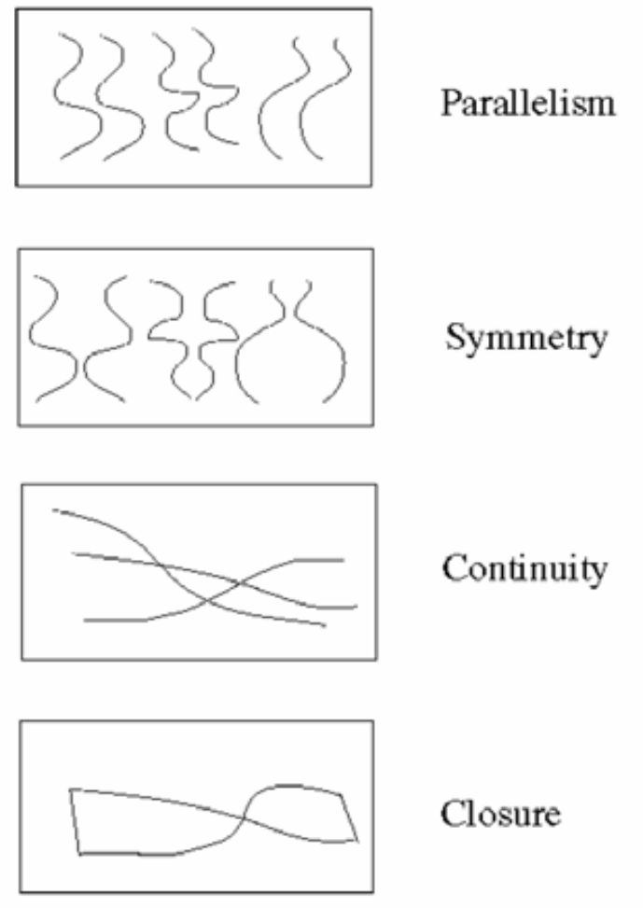
Motion and perceptual organization
Sometimes, motion is the only cue

Slide 31
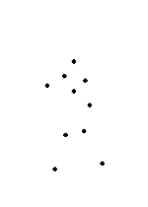
Motion and perceptual organization
Even “impoverished” motion data can evoke a strong percept
G. Johansson, “Visual Perception of Biological Motion and a Model For Its Analysis", Perception and Psychophysics 14, 201-211, 1973.

Slide 32
Motion and perceptual organization
Even “impoverished” motion data can evoke a strong percept
G. Johansson, “Visual Perception of Biological Motion and a Model For Its Analysis", Perception and Psychophysics 14, 201-211, 1973.

Slide 33
Uses of motion
Estimating 3D structure
Segmenting objects based on motion cues
Learning and tracking dynamical models
Recognizing events and activities
Improving video quality (motion stabilization)

Slide 34
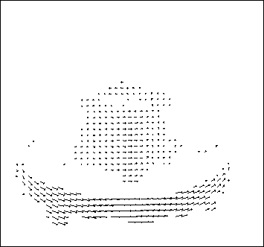
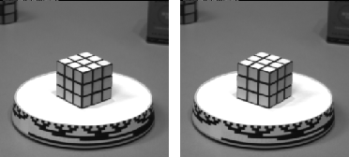
Motion field
The motion field is the projection of the 3D scene motion into the image
What would the motion field of a non-rotating ball moving towards the camera look like?

Slide 35
Optical flow
Definition: optical flow is the apparent motion of brightness patterns in the image
Ideally, optical flow would be the same as the motion field
Have to be careful: apparent motion can be caused by lighting changes without any actual motion
  Think of a uniform rotating sphere under fixed lighting vs. a stationary sphere under moving illumination

Slide 36
Lucas-Kanade Optical Flow
Same as Lucas-Kanade feature tracking, but for each pixel
  As we saw, works better for textured pixels
Operations can be done one frame at a time, rather than pixel by pixel
  Efficient

Slide 37
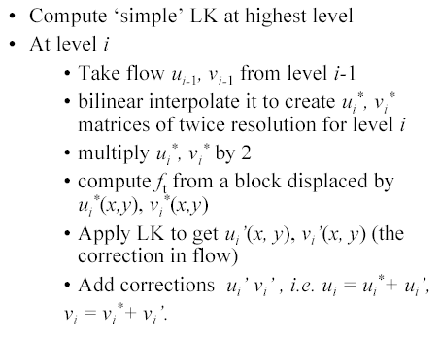
Multi-resolution Lucas Kanade Algorithm

Slide 38
Iterative Refinement
Iterative Lukas-Kanade Algorithm
  Estimate displacement at each pixel by solving Lucas-Kanade equations
  Warp I(t) towards I(t+1) using the estimated flow field
    - Basically, just interpolation
  Repeat until convergence
* From Khurram Hassan-Shafique CAP5415 Computer Vision 2003

Slide 39
Coarse-to-fine optical flow estimation
run iterative L-K
warp & upsample
run iterative L-K
.
.
.
image J
image I
image 1
image 2
Gaussian pyramid of image 1 (t)
Gaussian pyramid of image 2 (t+1)

Slide 40
Coarse-to-fine optical flow estimation
u=1.25 pixels
u=2.5 pixels
u=5 pixels
image H
u=10 pixels
image I
image 1
image 2
Gaussian pyramid of image 1
Gaussian pyramid of image 2

Slide 41
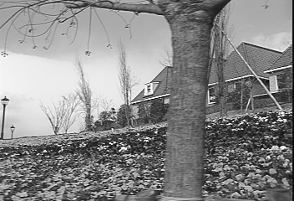
Example
* From Khurram Hassan-Shafique CAP5415 Computer Vision 2003

Slide 42
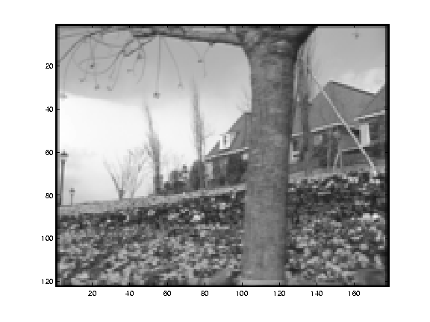
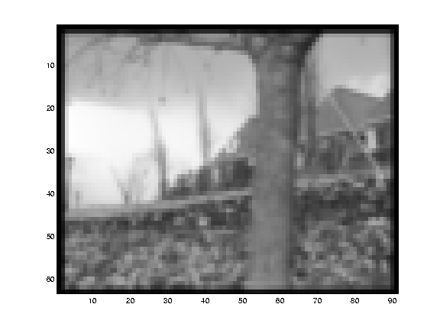
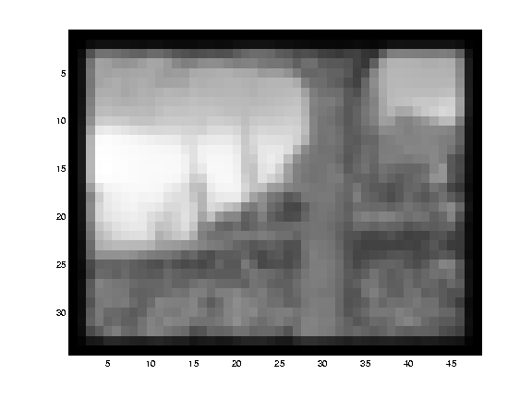
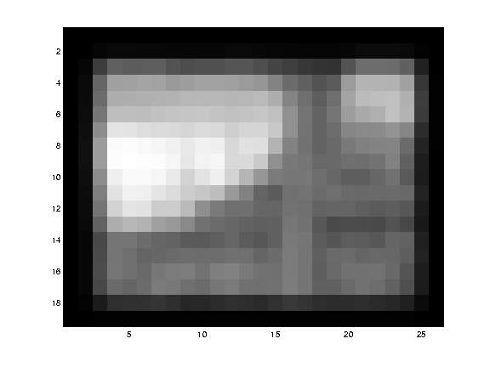
Multi-resolution registration
* From Khurram Hassan-Shafique CAP5415 Computer Vision 2003

Slide 43
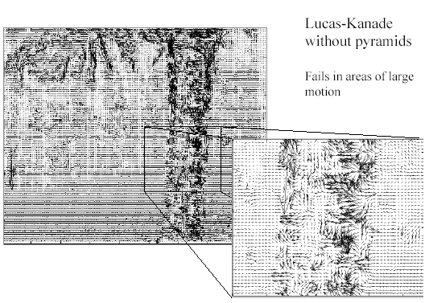
Optical Flow Results
* From Khurram Hassan-Shafique CAP5415 Computer Vision 2003

Slide 44
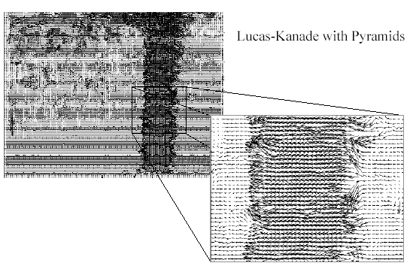
Optical Flow Results
* From Khurram Hassan-Shafique CAP5415 Computer Vision 2003

Slide 45
Errors in Lucas-Kanade
The motion is large
  Possible Fix: Keypoint matching
A point does not move like its neighbors
  Possible Fix: Region-based matching
Brightness constancy does not hold
  Possible Fix: Gradient constancy
Notes:
Iterative refinement:
Estimate velocity at each pixel using one iteration of Lucas and Kanade estimation
Warp one image toward the other using the estimated flow field
Refine estimate by repeating the process

Slide 46
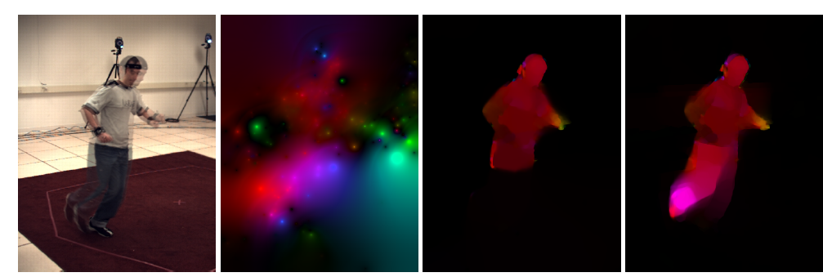
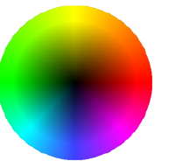
State-of-the-art optical flow
Start with something similar to Lucas-Kanade
+ gradient constancy
+ energy minimization with smoothing term
+ region matching
+ keypoint matching (long-range)
Region-based
+Pixel-based
+Keypoint-based
Large displacement optical flow, Brox et al., CVPR 2009

Slide 47
Stereo vs. Optical Flow
Similar dense matching procedures
Why don’t we typically use epipolar constraints for optical flow?
B. Lucas and T. Kanade. An iterative image registration technique with an application to
stereo vision. In Proceedings of the International Joint Conference on Artificial Intelligence, pp. 674–679, 1981.

Slide 48
Summary
Major contributions from Lucas, Tomasi, Kanade
  Tracking feature points
  Optical flow
  Stereo (later)
  Structure from motion (later)
Key ideas
  By assuming brightness constancy, truncated Taylor expansion leads to simple and fast patch matching across frames
  Coarse-to-fine registration

Slide 49
Next week
Epipolar geometry and stereo
Structure from motion

